Slide 1
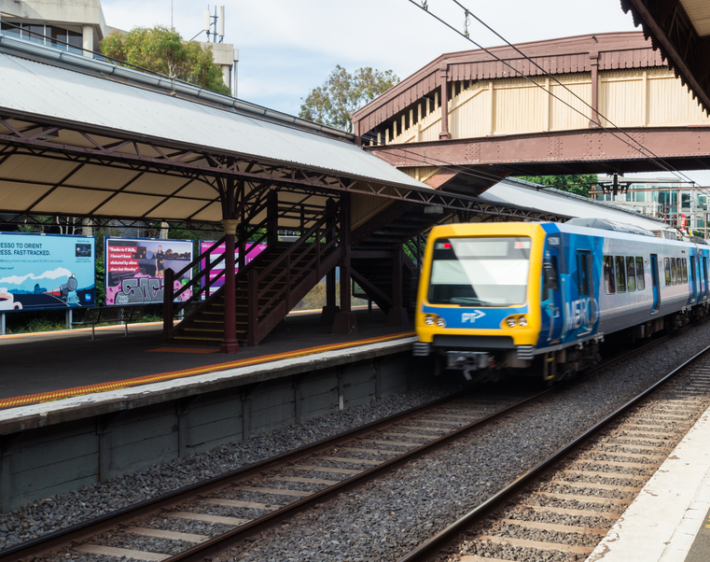
Train Station & House Price Analysis
Notes:
Transport is one of the most critical elements when it comes to buying a property. This analysis will focus on train stations around a suburb with a 3KM radius.

Slide 2
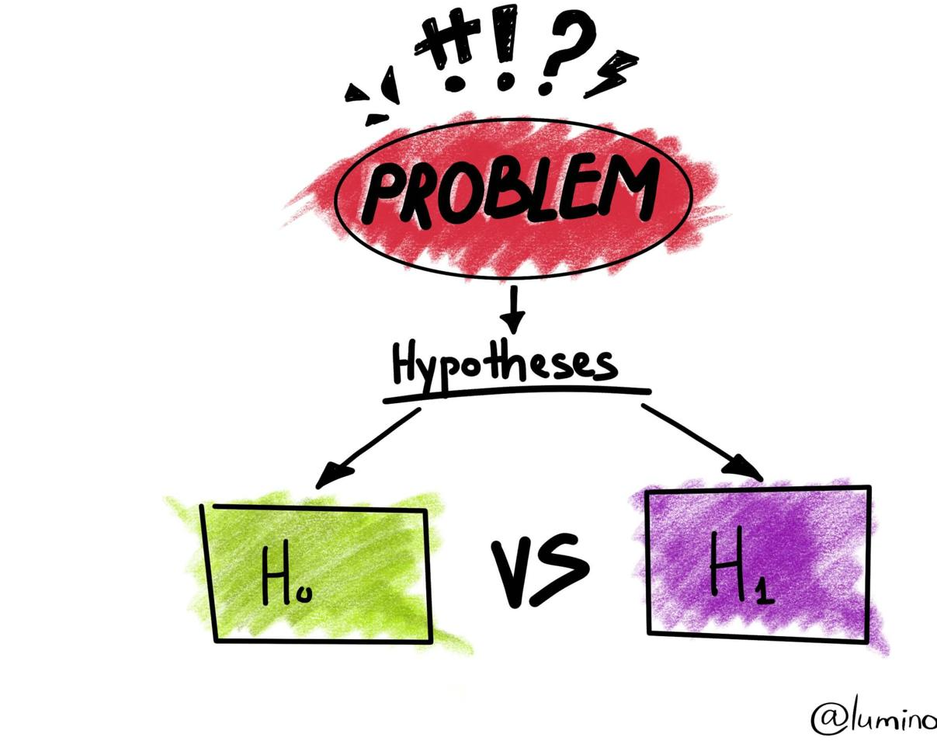
Hypothesis:
A positive relationship between the house price and the number of train station surrounding the suburb
Notes:
The reason behind this analysis is to try and figure out the relationship between house price and train station

Slide 3
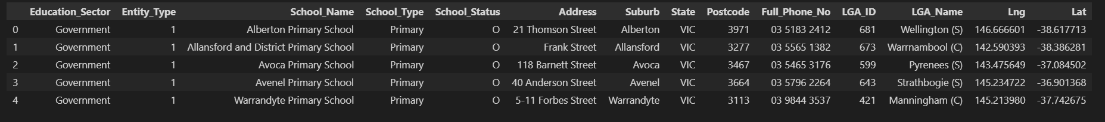
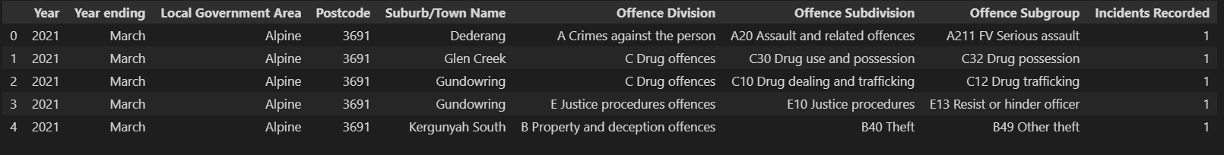
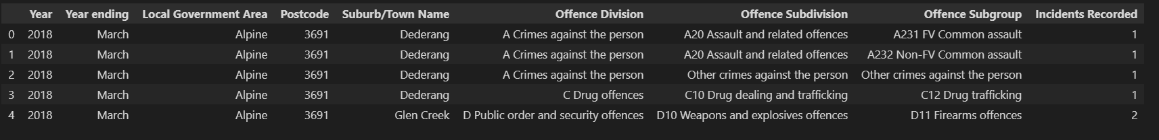
Data Cleaning
Before
After
Before
After
Before
After

Slide 4
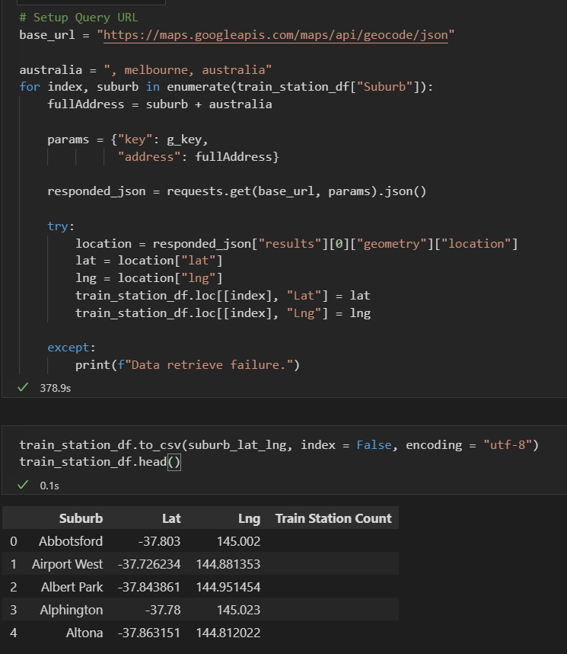
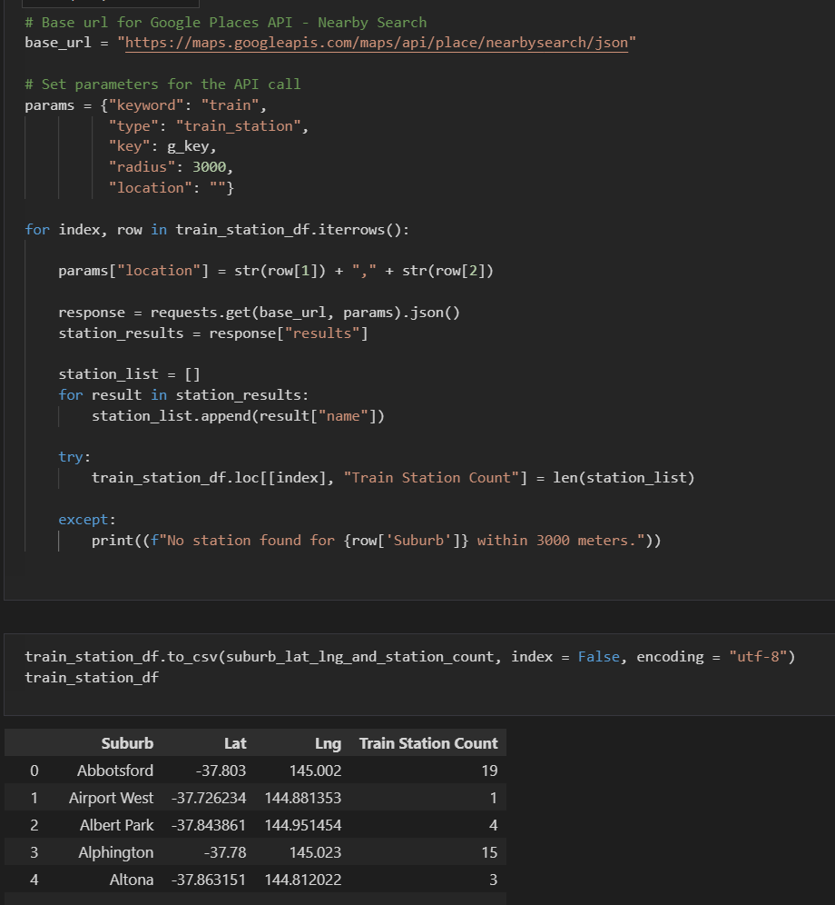
Collecting Data via API call

Slide 5
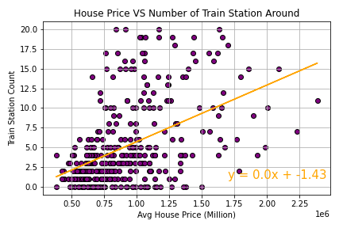
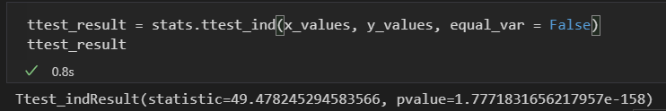
Conclusion based on this analysis: House price and number of train stations surrounding have a positive relationship

